Slide 1
Marketing Analytics
Jessica Goodman
Amala Miriyala
Joseph Moore
Freyan Pochkhanawalla
Abhijeet Pokhriyal
Fall 2019
Dr. Ming Chen
Notes:
Team introduction

Slide 2
Overview
Case: “Ombre, Tie-Dye, Splat Hair: Trends or Fads? “Pull” and “Push” Social Media Strategies at L’Oréal Paris”
Objective: Review the hair dye market to provide recommendations for ongoing marketing strategy
Approach: Review Google trends, social media analytics and pricing data
Notes:
Our research and analysis focuses on the case study on L’Oreal Paris. What we did was review the hair dye market, look at current trends and changes with L’Oreal and the competitors. Our analysis focused on Google trends, social media analytics and Amazon pricing.

Slide 3
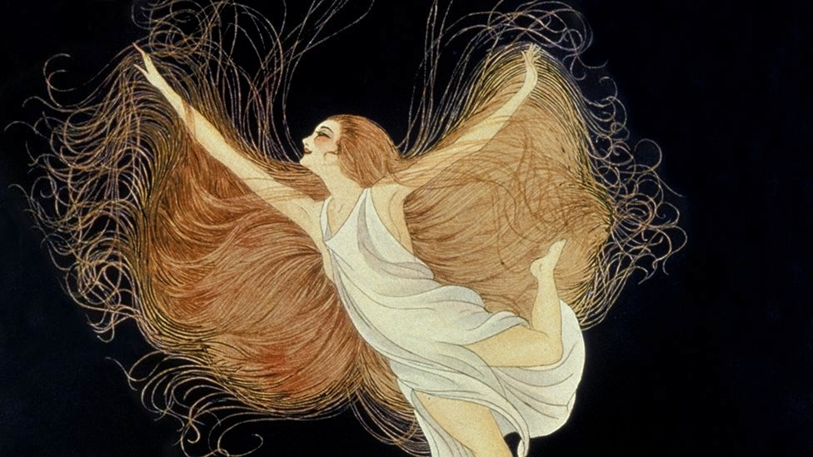
History
Eugene Schueller
In 1909, a young French chemist researching on beauty products invented a new hair color formula and called it Oreale.
Company
Eugene Schueller started manufacturing and marketing hair dye products to local salons in France under company name Teintures Inoffensives pour Cheveux which manifested into L’Oreal.
© L'Oréal Archives/Jean-Claude
Path to Success
L'Oreal's smart strategies and creativity in product development revolutionized hair coloring products by introducing corrosion-free bleaches & dyes, and one-step hair coloring products. L'Oreal principles and investments in R&D paved the way to be number one in the industry.
Notes:
L’Oreal is one of the largest cosmetic brands in the world. It was started by Eugene Schueller in 1909 with a new hair color formula as Oreale.
The hair dye formulas were marketed in France.
They currently own 500 brands.

Slide 4
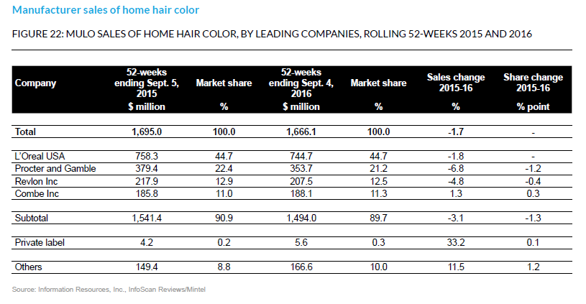
Market and Competition Overview
Notes:
(Jessica) L’Oréal dominates home hair color sales, capturing 45% of MULO sales. Smaller players such as Combe and Schwarzkopf were able to steal share from middle players such as P&G (Procter and Gamble) and Revlon as they stay on-trend with temporary formats and bold colors. However, Coty’s recent acquisition of P&G’s Clairol will shake up market share moving forward.
Successful sales of Black haircare brands and of Combe’s Just For Men will encourage other brands to expand offerings directed at these underserved populations.

Slide 5
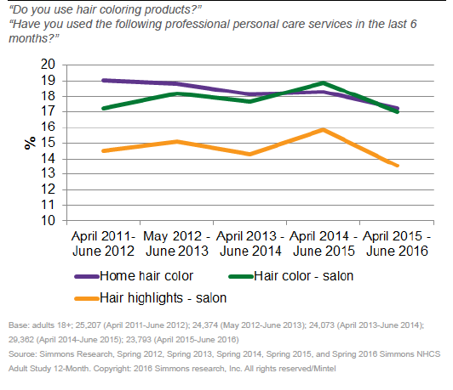
Notes:
Use of Salon Hair Color - 2011 - 2016
Information is from the Mintel report in 2017 on Hair Dye Products

Slide 6
Opportunities within the Market
Healthier Alternatives to
Traditional Hair Dye
Alternate Market Segments
Consumers Turning to New Trends
1
2
3
Notes:
In our market research we found that the traditional market for hair dye (i.e. the all over color) has remained stagnant or shrunk. Consumers are more likely to go more natural. There are concerns about the chemicals in hair dye. New trends like Ombre have become an acceptable alternative because you can go longer between touch-ups since you are showing your roots.
While the traditional hair dye market remains stagnant (which tends to be older, white women), there is growth for hair dye with underrepresented groups including black haircare products.
The market is also starting to shift to color for fun instead of the functional purpose of hiding gray. Temporary hair color and root touch-ups represent bright spots in the home hair color category. Both formats appeal to those who are concerned about hair damage from using all-over permanent hair color, as these formats are perceived as being gentler on hair.

Slide 7
Challenge 1: Trend vs Fad
Challenge 2: Deciding on a Marketing and Social Media Strategy
Notes:
The case really brought up two challenges for us to investigate. We looked into these newer trends and then we looked at social media and pricing to provide detailed recommendations. I will turn it over to Joe.

Slide 8
Google Research
Trend vs. Fad
Why is it so important to identify a fashion movement early?
What’s the difference in the fashion industry?
How can Google help?
What type of data can google provide?
Incorporating data driven decision making
Notes:
Joe
Fads: Glitter Hair, Over-sized buns, Dirty Brunette, Faded Pastel
Trends: Things that stick through time: Ombre hair coloring through the 2010s, Tie-Dye hair since 2016

Slide 9
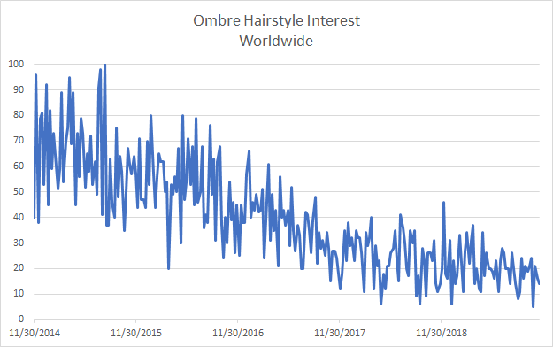
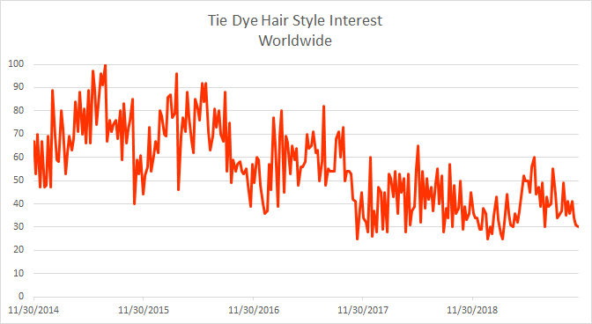
Using Google to Identify Trends in Fashion
Notes:
Joe

Slide 10
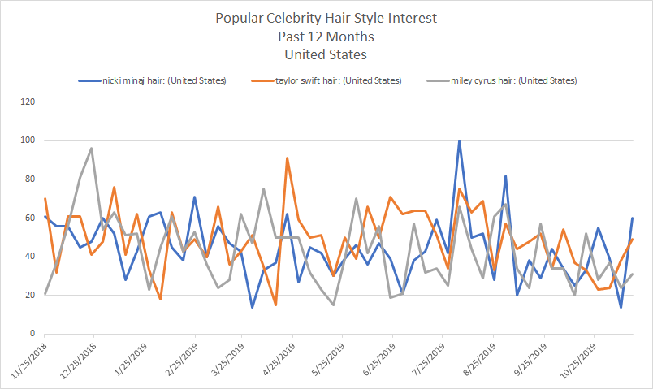
Celebrity Fashion Signals
Celebrities can be early signals for future fashion trends or fads in women hairstyle.
Utilizing their partnership with google can help L’Oreal’s product innovation team stay ahead of consumer demand
Notes:
Joe

Slide 11
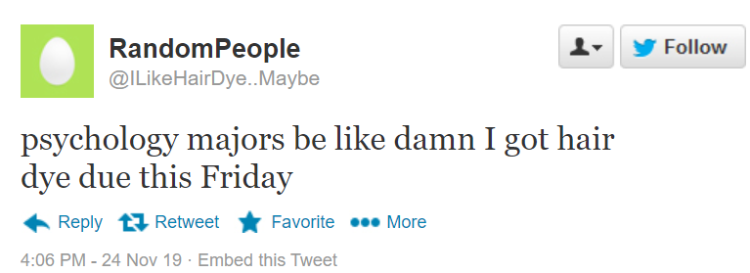
Analysis: Social Media
Code @Github
Notes:
Abhijeet

Slide 12
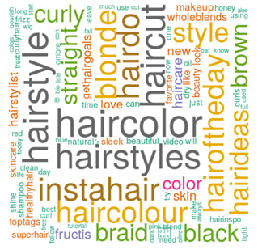
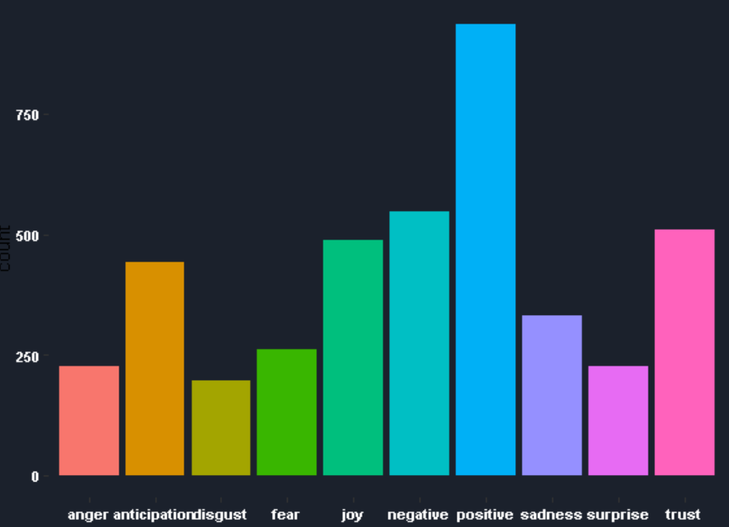
Analysis: Social Media
Consumers
Notes:
Abhijeet

Slide 13
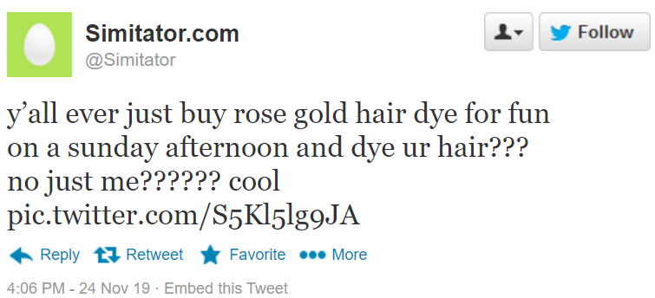
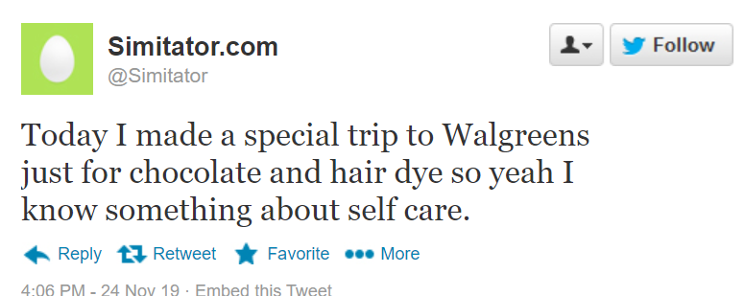
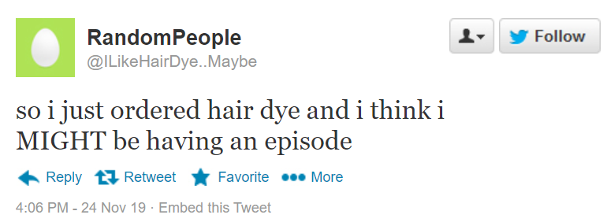
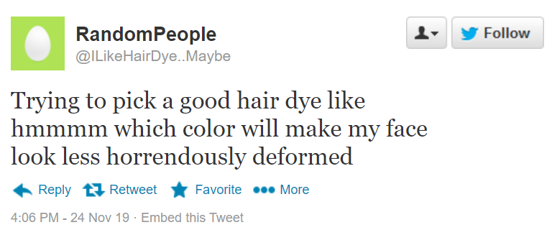
Impulsive
Notes:
Abhijeet

Slide 14
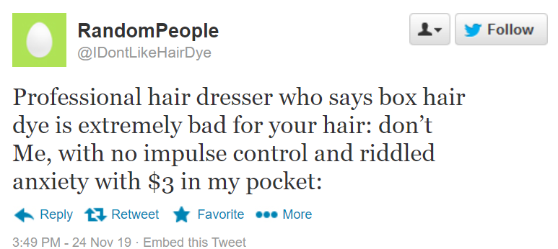
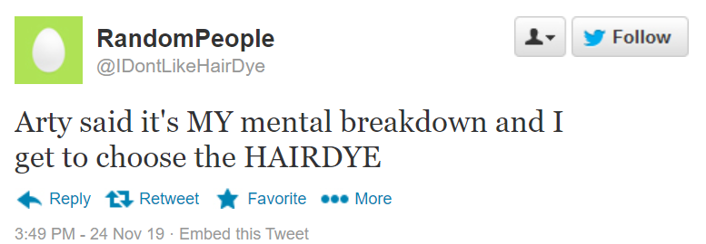
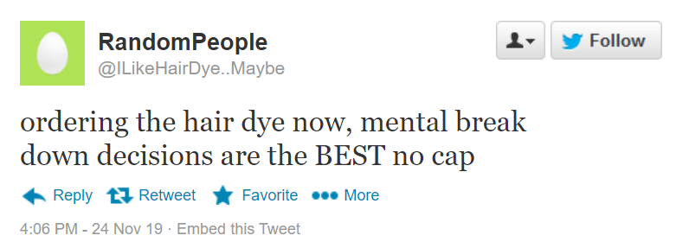
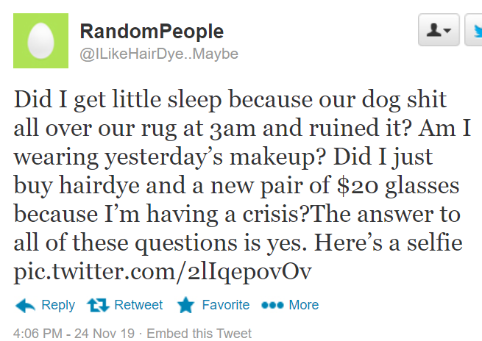
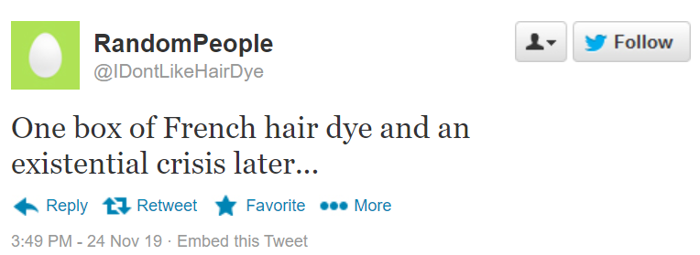
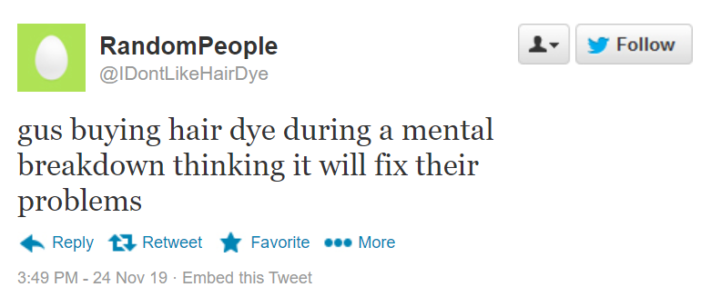
Feeling the blues
Notes:
Abhijeet

Slide 15
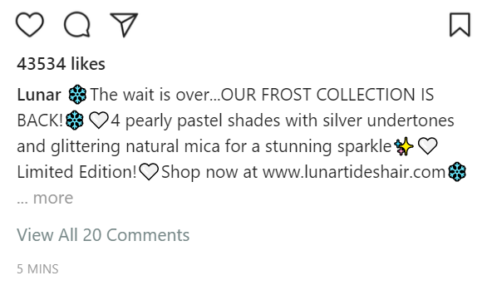
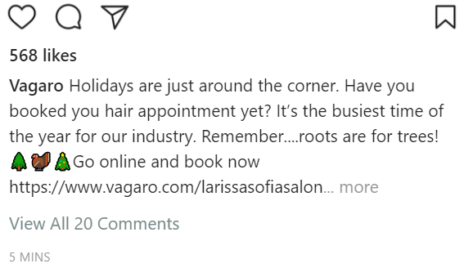
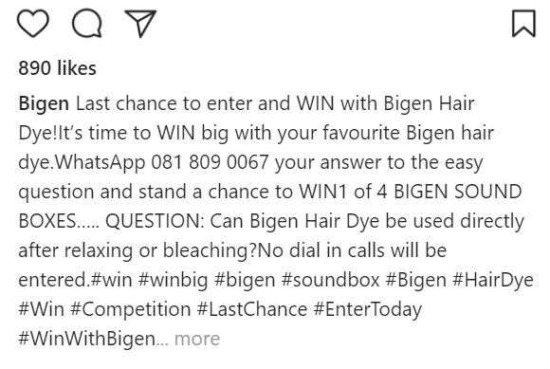
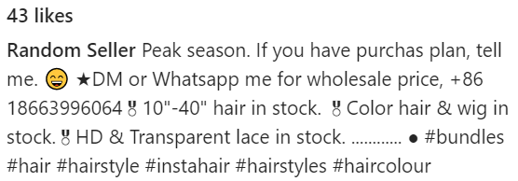
Instagram Marketing
Element of Time
Notes:
Abhijeet

Slide 16
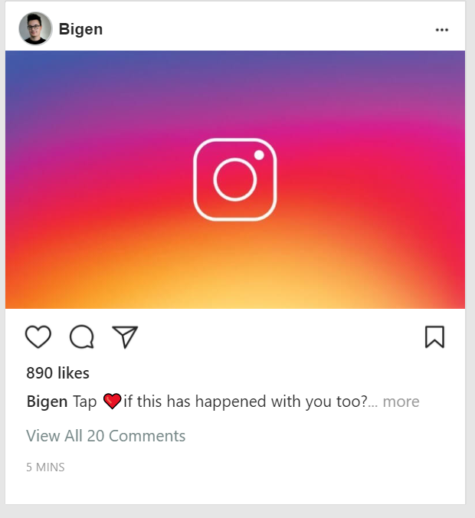
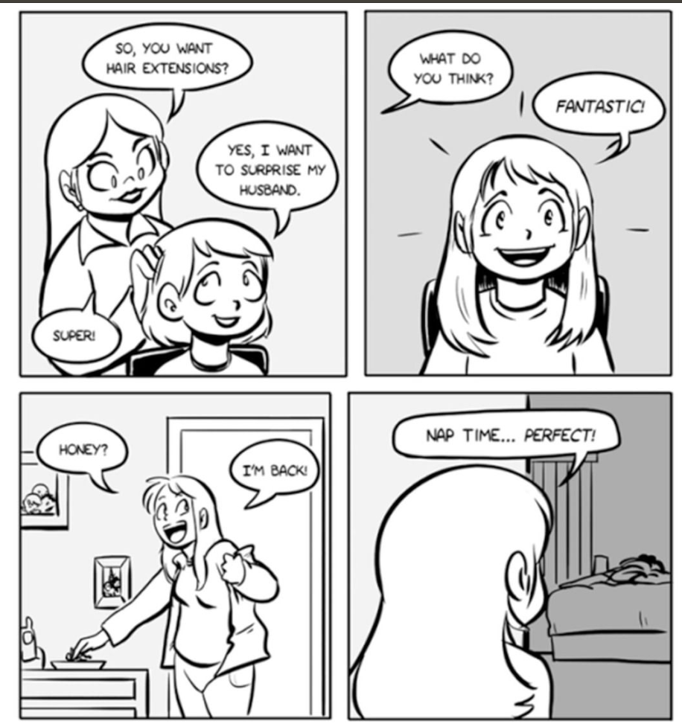
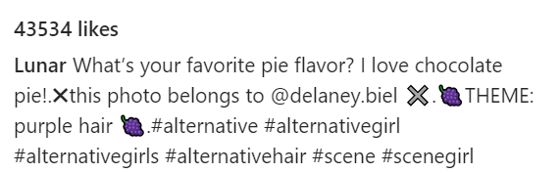
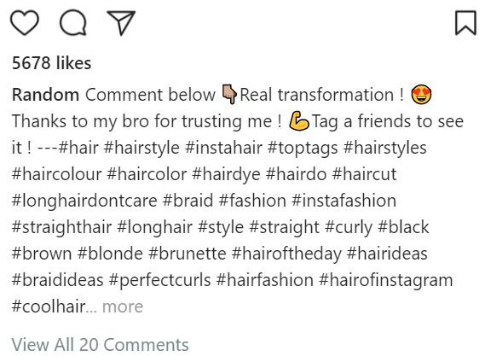
Engagement
Notes:
Abhijeet

Slide 17
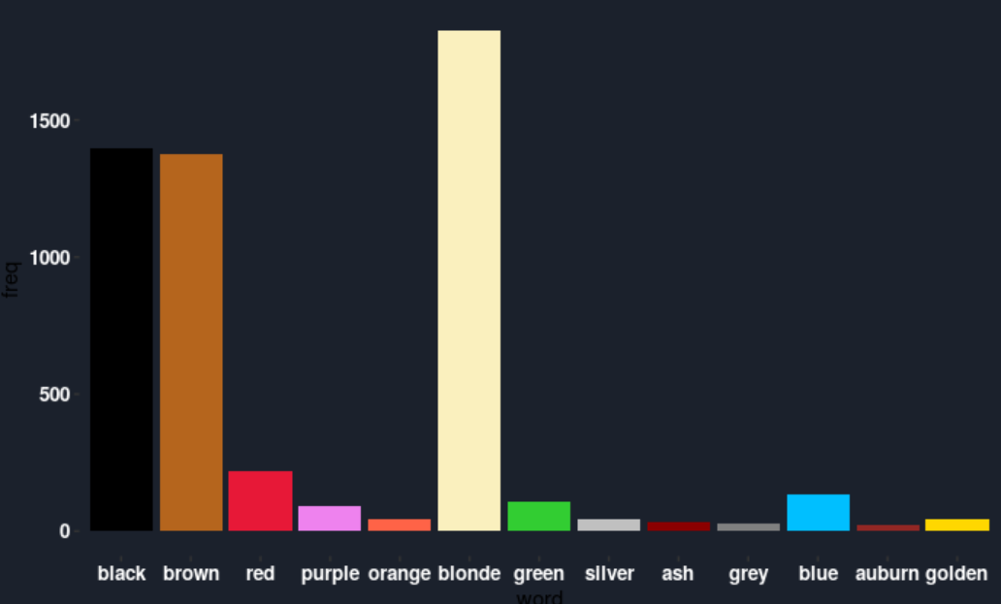
Product
Notes:
Abhijeet

Slide 18
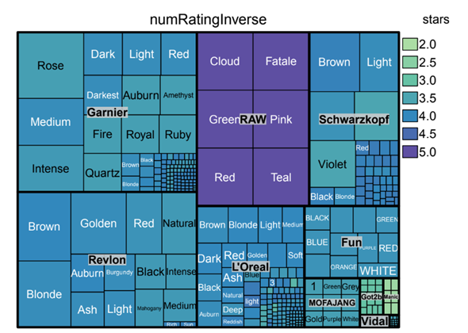
Vibrance
Notes:
Abhijeet

Slide 19
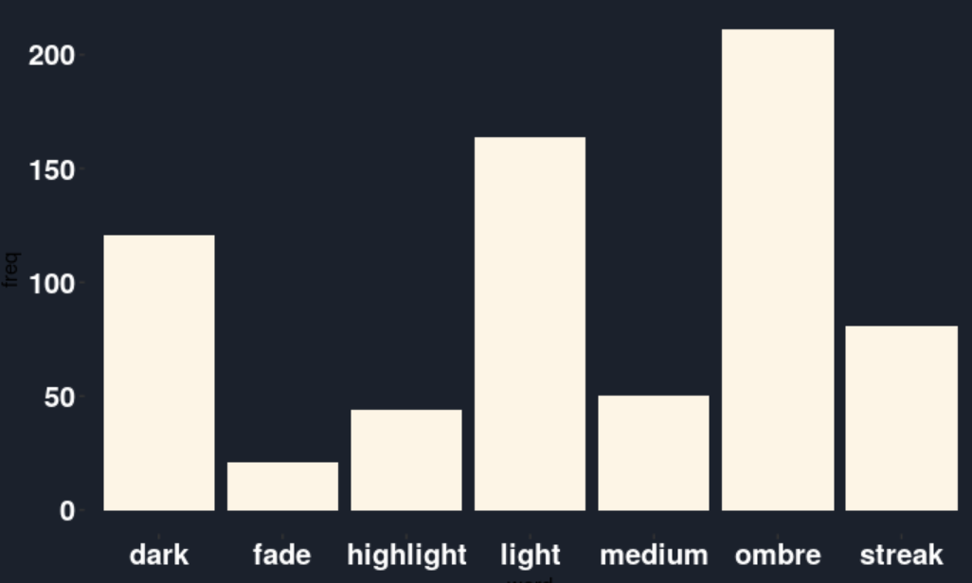
Notes:
Abhijeet

Slide 20
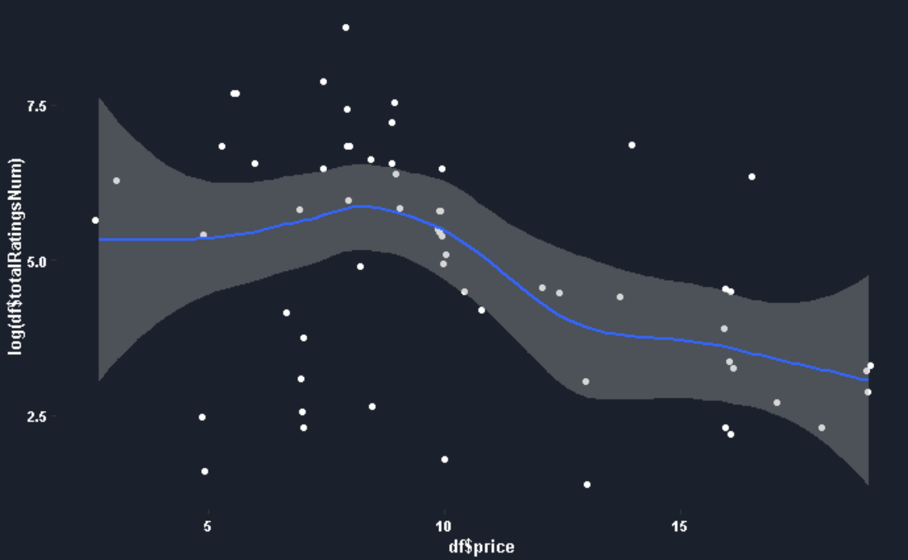
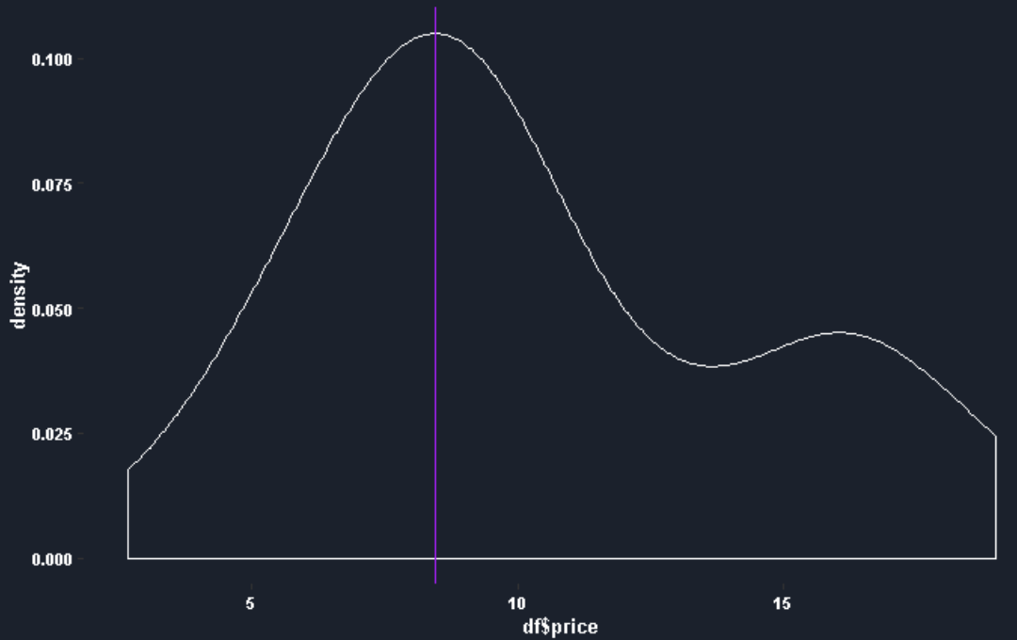
Analysis: Amazon Pricing
Pricing
Notes:
Abhijeet

Slide 21
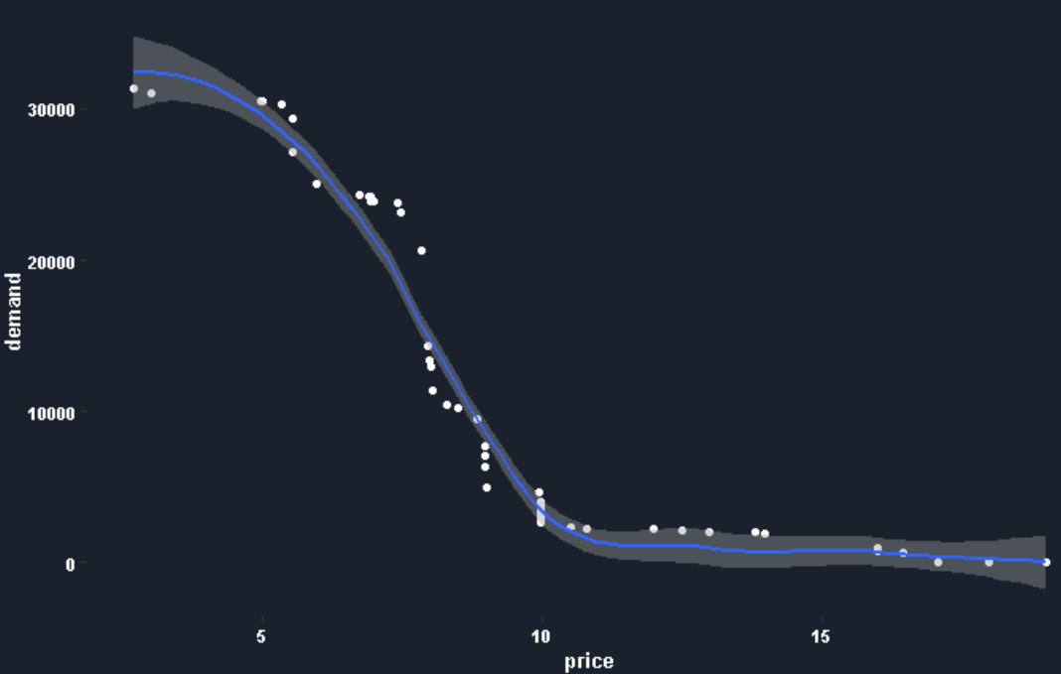
Demand Curve
Notes:
Abhijeet

Slide 22
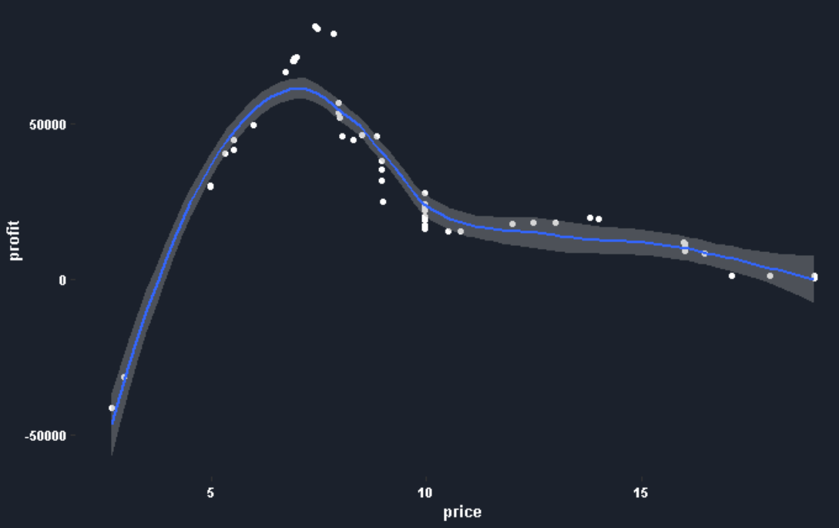
Assuming cost = $4
Notes:
Abhijeet

Slide 23
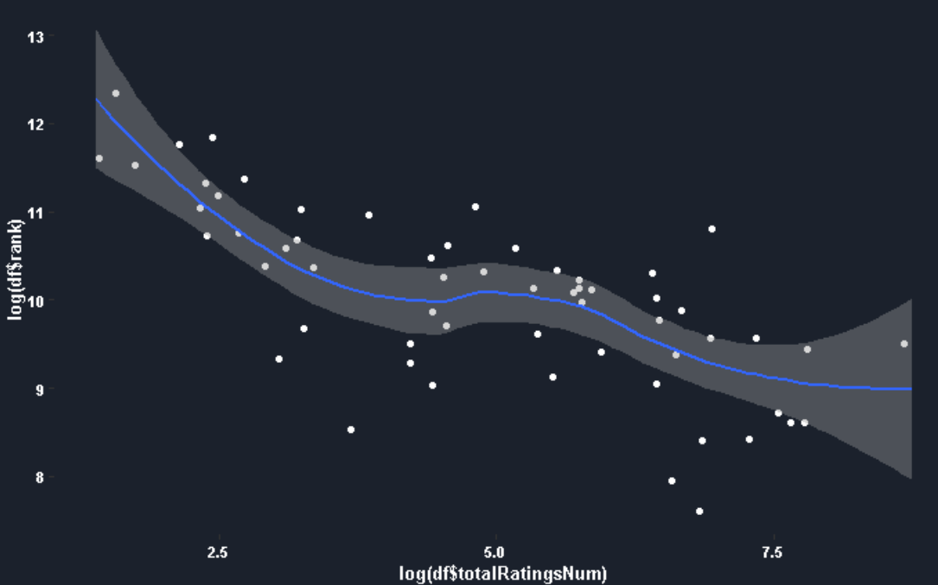
Why pricing is important ? Not just profits directly but efficiency of the channel….
Notes:
Abhijeet

Slide 24
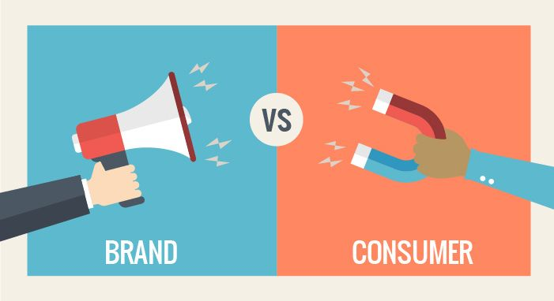
Challenges
Notes:
How to effectively combat pull challenges: be at the right place at the right time, when the consumer is about to make a purchase decision and is “pulling” for information on the web. This could be a google search, a comment on social media, a conversation between friends that leads to a search for a product or service.
Avoid “Prospect fatigue”: if you bombard the market with constant messaging, apart from being extremely expensive it also leads to prospect fatigue. People grow weary of your ads and do not associate with your product.
Push challenge: how a company can effectively package is product and messaging and push it out to an audience is a skill set saves the audience from having to “pull” the information themselves.
The ideal scenario is effectively analysing the pull messaging to push out packages that are easy to consume and adapt.

Slide 25
Recommendations
PULL INSIGHTS | PUSH RESPONSES
-Customers are impulsive - Design ads around impulse
Shopping. “Feeling down?”
-Smaller groups have potential -Price Vibrant colors
competitively
-Customers need to remember -Encourage opinions and
the product conversations continuously.
Notes:
:design ads around this impulsive behavior “feeling down? Nothing like a fresh look.”
:smaller group that purchases vibrant colors are reviewing it at 5 stars. Price these colors accordingly to capture this market
:Be topical, posts according to current seasons and encourage conversations- ask about peoples opinions.
:As demand deccreases, rank on amazon falls (number of people rating the product). Price it competitively to be on the first page

